Slide 1
ABC Retailers Report Author: Hlengiwe Nicholas Overview of Credit Product Trends:
Content:
Introduction to ABC Holdings Ltd. and ABC FS:
ABC Holdings Ltd. is a prominent retail chain operating in South Africa.
ABC Holdings has a financial services arm, ABC FS, established in partnership with a local bank in the early 2000s.
ABC FS offers a single credit card product to its customers.
Objective of the Analysis:
To provide the executive team with insights into the trends over the past 2 years.
To forecast future trends and provide data-driven recommendations for strategic decision-making.
Summary of the Dataset:
The dataset comprises summarised monthly purchase data spanning from January 2019 to December 2020.
Key columns include:
Product Held: Product holding as at month of purchase.
Year_Month: The month that the purchases were made in.
Business Unit: Major subcategories include Clothing, Groceries, Toys, and Other.
No_Customers: Number of unique customers shopping in the month.
No_Baskets: Number of unique baskets purchased in the month.
Paid using ABC Credit Card: Total amount (R’s) purchased using ABC Credit Card.
Paid using Competitor Credit Card: Total amount (R’s) purchased using Competitor Credit Card.
Total Purchases: Total value of items purchased by ABC customers using any form of Credit Card.

Slide 2
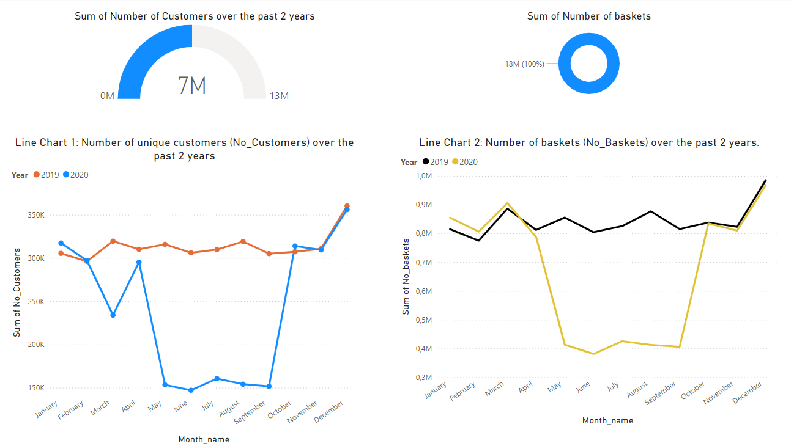
Analysis of past Trends (2019-2020)
Customer Behavior insight
Overall Customer and Basket Trends:
From the gauge visual, we observe that over the past two years, we have received a total of almost 17 million customers.
The donut visual shows that we sold almost 18 million baskets during the same period.
Monthly Trends:
Line Chart 1 tracks changes in the number of unique customers over time.
Line Chart 2 monitors the number of baskets (transactions) over time.
Seasonal Patterns:
Over the past two years, Line Chart 1 reveals a consistent decline in the number of customers during January and February.
Conversely, November and December show a consistent increase in the number of customers, indicating peak shopping periods.
Therefore, we can conclude that peak shopping periods are in November and December, while periods of customer loss typically occur in January and February.
Correlation Between Customers and Baskets:
Line Chart 1 and 2 indicate a direct relationship between the number of customers and the number of baskets sold.
When the number of customers decreases, the number of baskets sold also decreases.
Similarly, when the number of customers increases, the number of baskets sold also increases.
In 2020:
Both line charts show a significant decrease in the number of customers and baskets from April to May 2020.
There was a notable increase in these metrics from September to October 2020.
This fluctuation is likely due to the impacts of COVID-19 and related lockdown measures during that period.

Slide 3
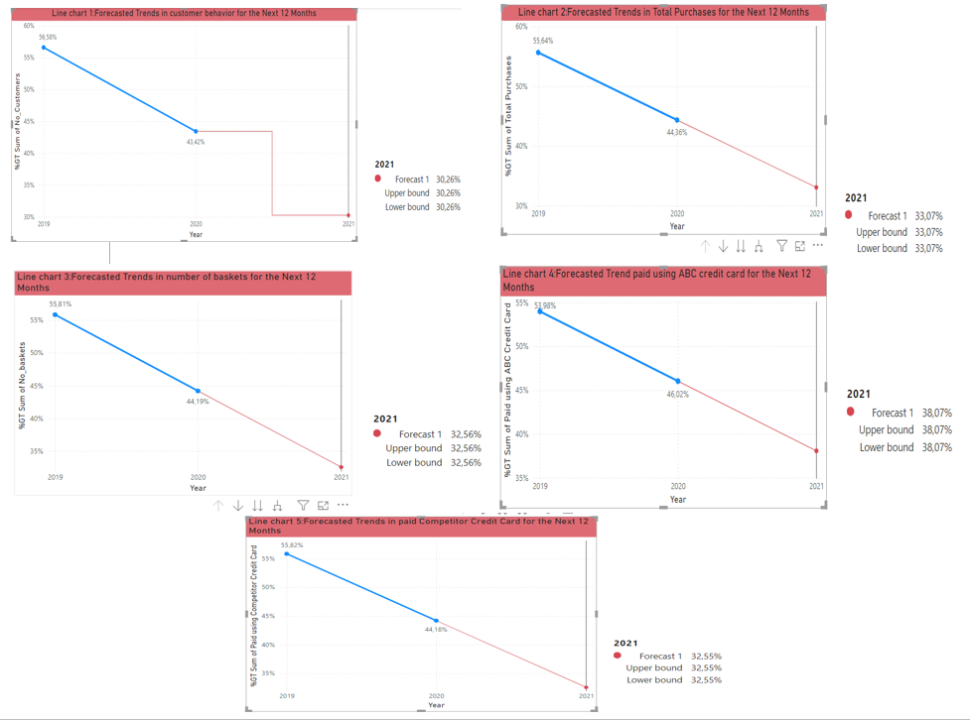
Forecast For The Next 12 Months (2021-2022)
Predictions for 2021:
Number of Customers: The number of customers will decrease by approximately 13%.
Total Purchases: The total number of purchases will decrease by approximately 11%.
Number of Baskets: The number of baskets (No_Baskets) will decrease by approximately 11%.
Payments Using ABC Credit Card: In 2021, 38.07% of total purchases will be paid using the ABC Credit Card.
Payments Using Competitor Credit Card: In 2021, 32.55% of total purchases will be paid using a competitor’s credit card.
Factors Influencing the Forecast:
Economic Conditions: The ongoing economic impact of COVID-19.
Competitive Landscape: Changes in the market dynamics and competition.

Slide 4
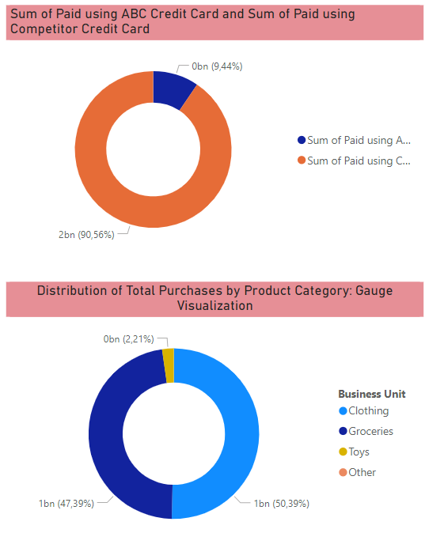
Recommendations
1. Enhancing ABC Credit Card Usage:
Insight: From the first chart, most customers prefer using competitors' credit cards compared to the ABC Credit Card.
Strategies to increase ABC Credit Card usage:
Marketing Strategy: Offer discounts or reward points to customers who make purchases using the ABC Credit Card.
Loyalty Programs: Develop loyalty programs that provide exclusive benefits for ABC Credit Card holders.
2. Targeted Promotions for Low-Performing Business Units:
Insight: The second chart indicates that the least selling items are in the 'Toys' and 'Other' business units.
Focus on promoting these underperforming categories:
Targeted Promotions: Run special promotions or discounts specifically for the 'Toys' and 'Other' categories to boost sales.
Product Bundling: Offer bundles that include toys or items from the 'Other' category with popular products to increase their visibility and appeal.

Slide 5
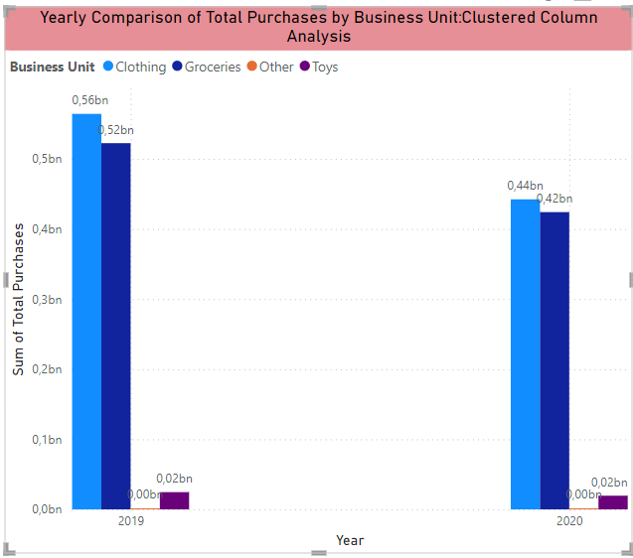
Recommendations- Part 2
3. Customer Retention and Acquisition Strategies:
Personalized Engagement:
Send personalized emails and messages highlighting new arrivals and promotions relevant to each customer’s shopping behavior.
Customer Feedback:
Regularly collect customer feedback and make necessary improvements to products and services based on the feedback.
Social Media Campaigns:
Use social media platforms for targeted ad campaigns to attract new customers and engage existing ones.
4. Investing in High-Performing Business Units:
Insight: High-performing business units such as 'Clothing' and 'Groceries' show significant potential for growth.
Invest in expanding these successful categories:
Product Range Expansion: Increase the variety of products offered in the 'Clothing' and 'Groceries' categories to attract a broader customer base.
Branch Expansion: Consider opening new branches in locations with similar demographics to existing high-performing stores to capture new markets.

Slide 6
Assumptions & Conclusions
Assumptions made during the analysis:
We assumed that in 2020 the business was affected by Covid-19.
We used the forecast option in power bi to make prediction.
Conclusion:
By leveraging these data-driven insights, ABC Holdings Ltd, can identify and capitalize on growth opportunities, ensuring continued success and market expansion.

